Slide 1

Development of methods for adaptive and optimal deployment of heterogeneous sensor array for accurate representation of air pollution and its sources
Pre-Thesis seminar - 7.8.2019
Idit Belachsen
Advisors: Associate Professors - Barak Fishbain, Shai Kendler
1/27

Slide 2
Table of contents
Introduction - air pollution monitoring (motivation), representation in time and in space, network deployment
Research hypothesis and objectives
Related work
Methods – background (Meteorology, Evolutionary Algorithms, Borg), problem formulation
Preliminary results
Summary and research plan

Slide 3
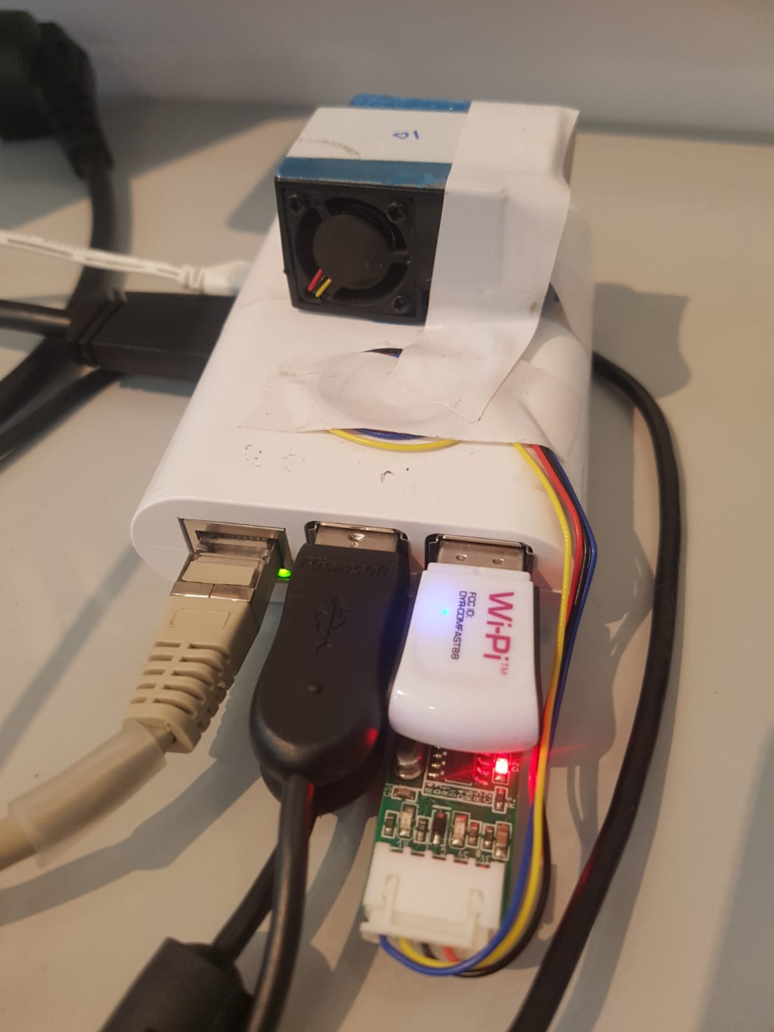
Air pollution monitoring
Major pollutants – NoX, CO, CO2, SO2, O₃, BC, other PM
The main incentive for air pollution monitoring:
Emission control
Short-term - prevent population exposure, regulatory enforcement
Long-term – epidemiological or climate research, planning
Major challenge – producing high resolution pollution concentration maps, using the current monitoring methods
Wireless Distributed Environmental Sensor Network (WDESN)
Portable and relatively low-cost Micro Sensing Units (MSUs)
Introduction

Slide 4
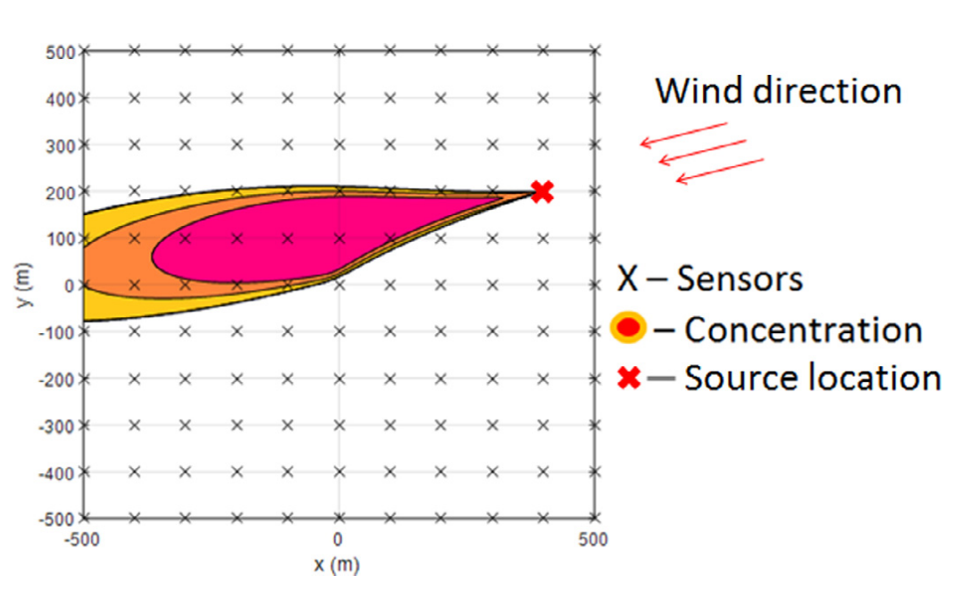
Representation in time and in space
IDW, KRIGING interpolation, LUR models
Atmospheric Transport and Dispersion (ATD) models
Knowledge on weather, location and quantity of the released pollutant is needed for ATD. If absent – STE can be applied
﻿Hutchinson et. al., 2017
Introduction

Slide 5
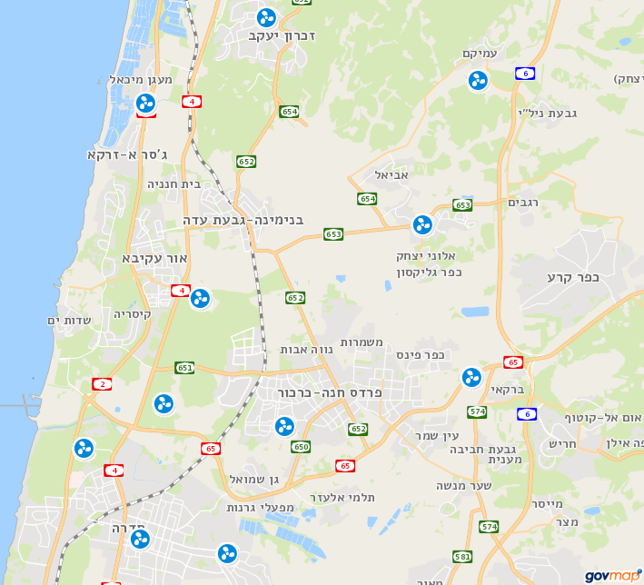

Network deployment
A new challenge is formed – what is the best way to deploy a network of sensors?
If resources are unlimited, the task is easy
The cost of a network is determined by – number of sensors and their attributes (sensitivity, dynamic range)
Practical considerations constrain some locations
Static deployment Vs. dynamic deployment
Introduction
Introduction
5

Slide 6
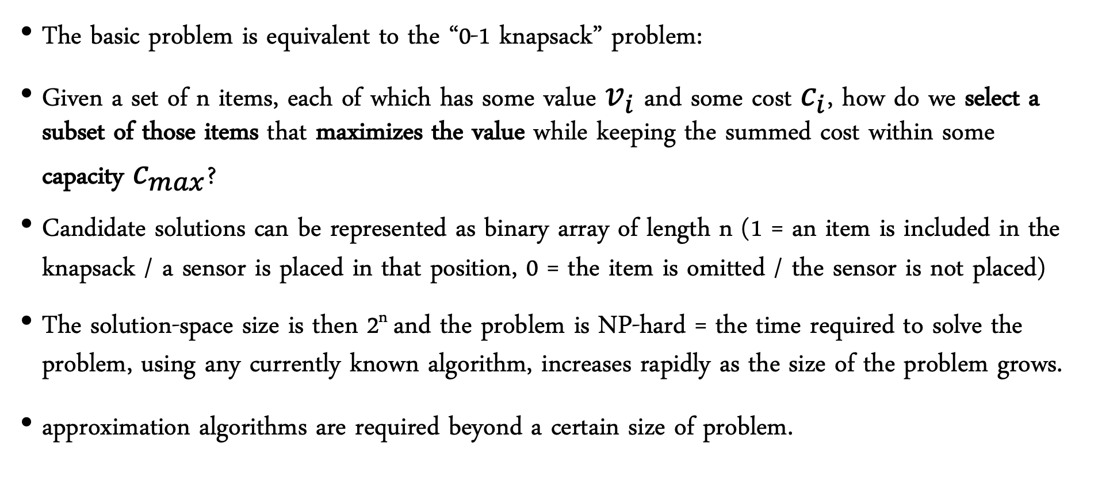
Network deployment
The basic problem is equivalent to the “0-1 knapsack” problem:
Given a set of n items, ﻿each of which has some value $v_{i}$ and some cost $c_{i}$, how do we select a subset of those items that maximizes the value while keeping the summed cost within some capacity $c_{max}$?
Candidate solutions can be represented as binary array of length n (1 = an item is included in the knapsack / a sensor is placed in that position, 0 = the item is omitted / the sensor is not placed)
The solution-space size is then 2^{n} and the problem is NP-hard = the time required to solve the problem, using any currently known algorithm, increases rapidly as the size of the problem grows.
approximation algorithms are required beyond a certain size of problem.
Introduction

Slide 7


Research hypothesis
An optimal deployment of a WDESN is required for the purpose of:
obtaining early warnings when an increase in industrial gas emission occurs
generating pollution dense maps
A set of optimal deployment solutions can be retrieved using multi-objective optimization techniques that balance between detection capabilities of the network and operational requirements.

Slide 8

Research objectives
General | Specific
To design and develop a decision-making tool for an optimal deployment in time and in space of heterogenous sensor array, that will allow decision-makers to discover tradeoffs between performance criteria and to consider alternative modes of action that may not have been apparent prior to the analysis. | Design an optimization model, comprised of the following modules:
 | A spatial optimization model A temporal optimization model A spatial-temporal optimization model
 | Consider: various sources/sensors configurations, weather conditions and emission rates, heterogenous network, case-study of real-world
8

Slide 9
Related work
The designated applications determines the goal that guides the optimization process. For example:
Population exposure assessment (Kanaroglou et al., 2005)
Threshold crossings detection (Boubrima et al., 2017)
Improve existing network performance (Berman et al., 2019)
Knowledge gaps
Predefined number of air pollution sensors
Relied on existing measurements from monitoring stations (instead of using a dispersion model)
Assumed a decay with distance from a pollution source
Ended up placing sensors at the highest mean pollution zones

Slide 10

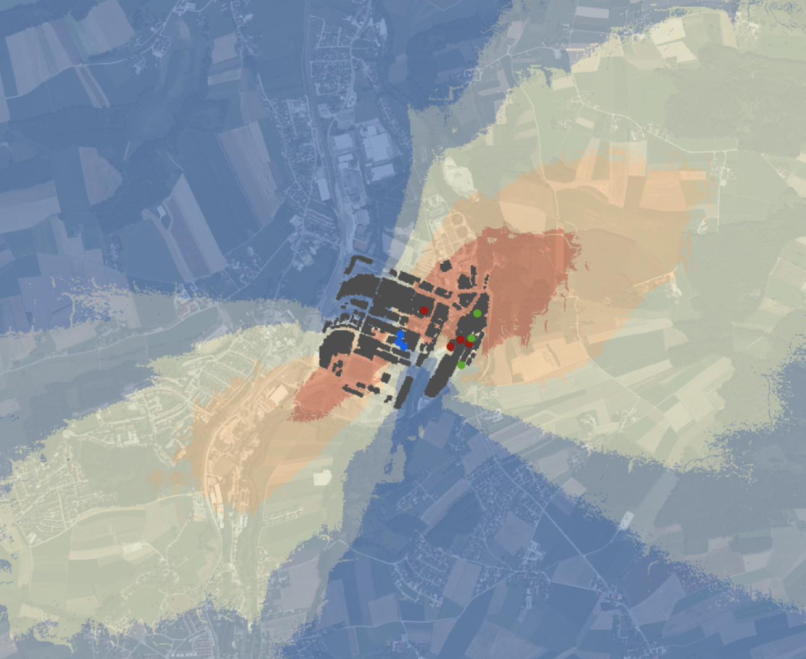

Methods - background
Atmospheric Transport and Dispersion (ATD) model
Optimization
Connect between emissions and predicted concentrations
What models exist?
The Gaussian plume model
What is multi-objective optimization?
What are Evolutionary Algorithms?
What is the Borg Framework?
Meteorology
Relevant meteorological parameters
Methods

Slide 11
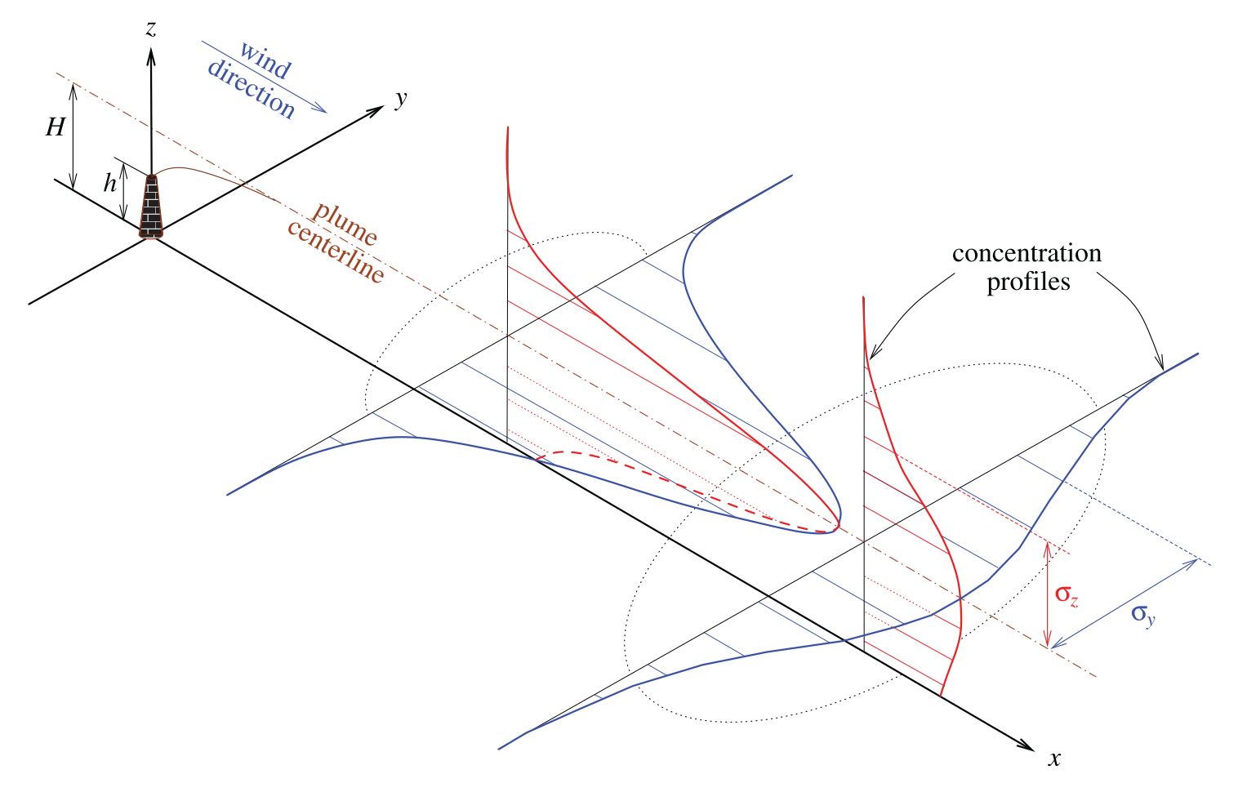
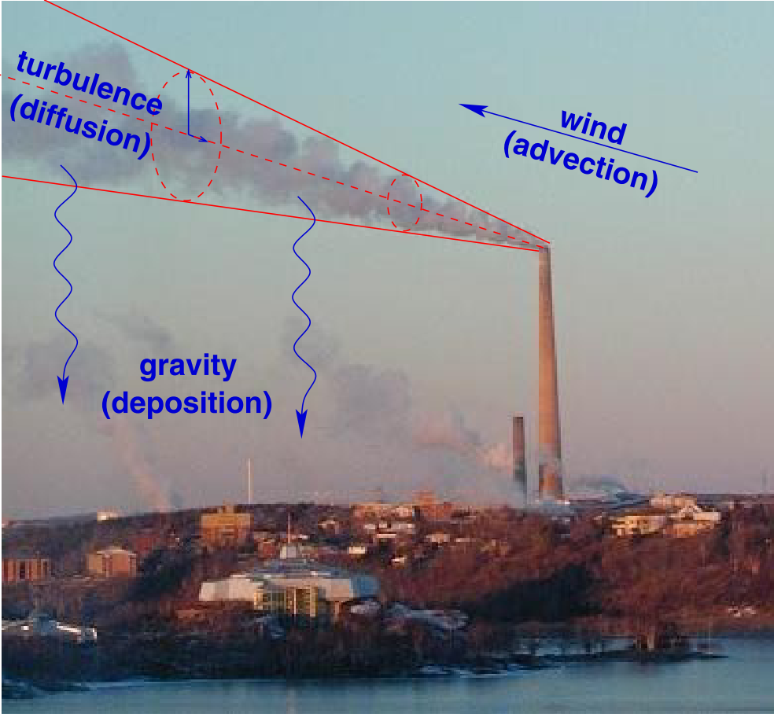
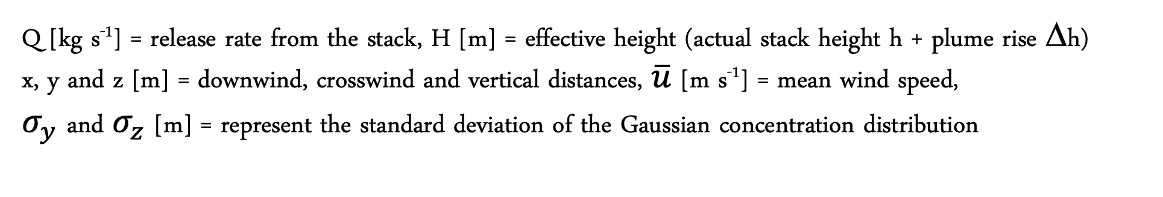
ATD models
Types: box models, Gaussian plume models, Lagrangian models, Eulerian dispersion models, Dense gas models
The Gaussian plume model - analytical steady state solution to the advection-diffusion equation for idealized circumstances
$$C\left(x,y,z,Q\right)=\frac{Q}{\overline{u}{σ_{y}σ}_{z}2π}exp\left(\frac{−y^{2}}{2σ_{y}^{2}}\right)\left[\exp\left(\frac{−{\left(z−H\right)}^{2}}{2σ_{z}^{2}}\right)+\exp\left(\frac{−{\left(z+H\right)}^{2}}{2σ_{z}^{2}}\right)\right]$$
Q [kg s⁻¹] = release rate from the stack, H [m] = effective height (actual stack height h + plume rise Δh)
x, y and z [m] = downwind, crosswind and vertical distances, $\overline{u}$ [m s⁻¹] = mean wind speed,
$σ_{y}$ and $σ_{z}$ [m] = represent the standard deviation of the Gaussian concentration distribution
Methods

Slide 12
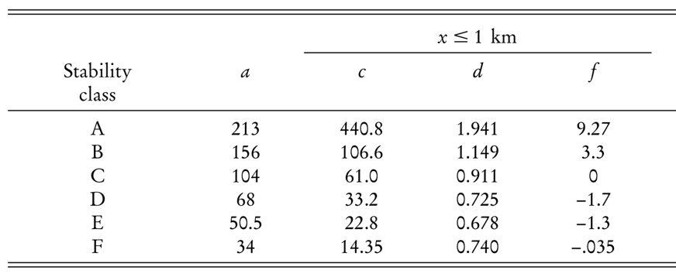
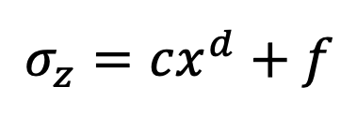
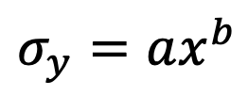
Main model assumptions
The solution is steady state.
The wind velocity is constant and aligned with the positive x-axis.
Variations in topography are negligible so that the ground surface can be taken as the plane z=0.
The pollutant does not penetrate the ground.
The material diffused is non-reactive in the atmosphere, with a negligible deposition rate
Background pollution is negligible
$$σ_{y}=ax^{b}$$
$$σ_{z}=cx^{d}+f$$
Methods

Slide 13
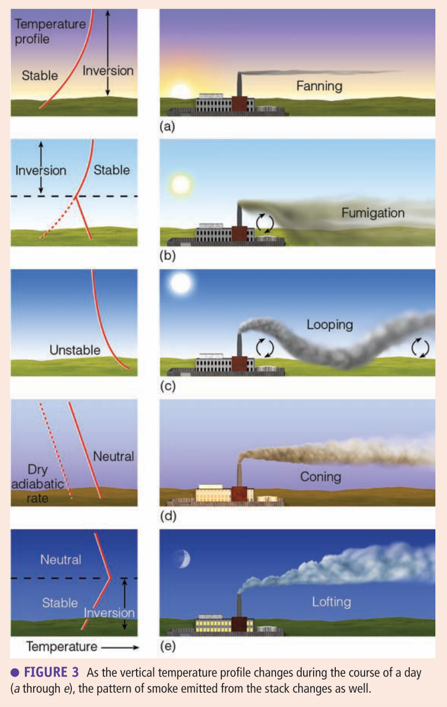
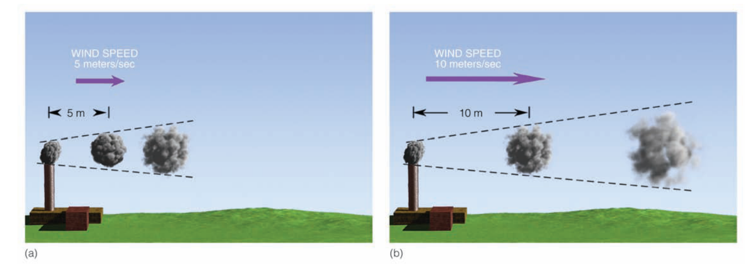
Meteorology
The meteorological parameters that play a role in any gas dispersion model are wind speed, wind direction, and the atmospheric stability condition.
﻿Ahrens and Henson, 2017
Methods

Slide 14
Multi-objective optimization
More than one objective function is optimized simultaneously, creating tradeoffs between conflicting objectives, such as - error rate and cost.
A Pareto frontier is the set of non-dominated solutions, being chosen as optimal, if no objective can be improved without harming at least one other objective.
Non-dominated
Solution
Dominated
solution
$min⁡(F_{1}\left(x_{1},x_{2},…x_{j},\right),$ $F_{2}\left(x_{1},x_{2},…x_{j},\right)…$ $F_{i}\left(x_{1},x_{2},…x_{j},\right))$
Pareto frontier
Hadka (2017)
Methods

Slide 15
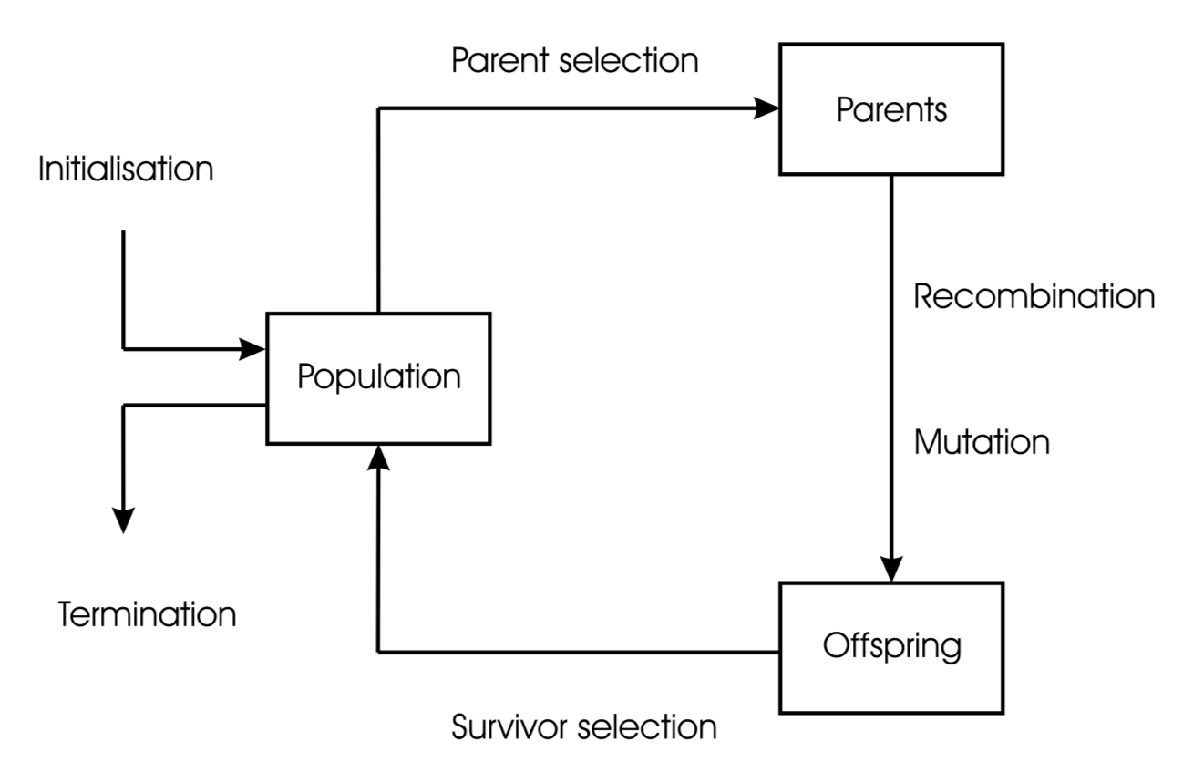
Evolutionary Algorithms
Environmental pressure causes natural selection. Better candidates are more likely to survive and reproduce
A set of candidate solutions
New
solutions
All solutions are Non-dominated
Methods
Eiben and Smith (2007)

Slide 16

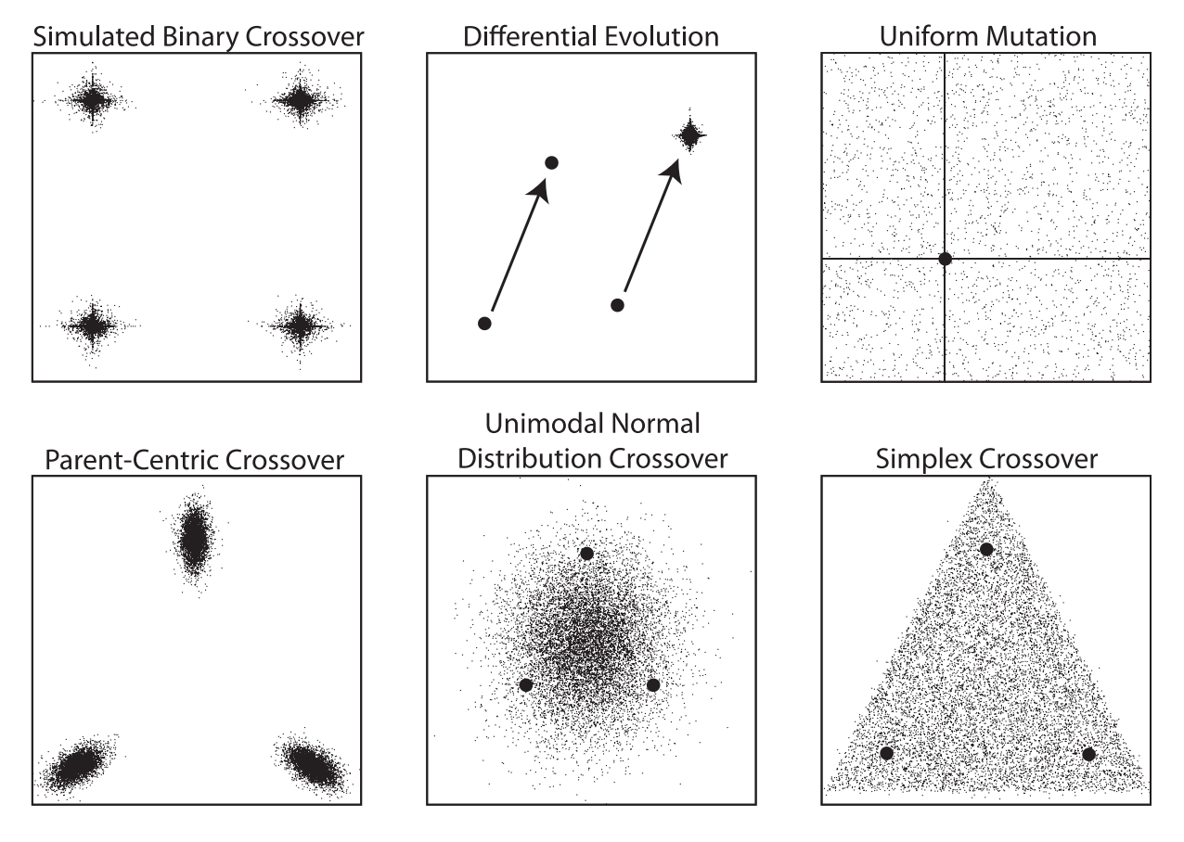
Borg MOEA
Developed by David Hadka and Patrick Reed
Classified as a hyper-heuristic global multi-objective search tool
Uses internal feedbacks to dynamically adapt an ensemble of genetic recombination operators
Hadka (2013)
Methods

Slide 17
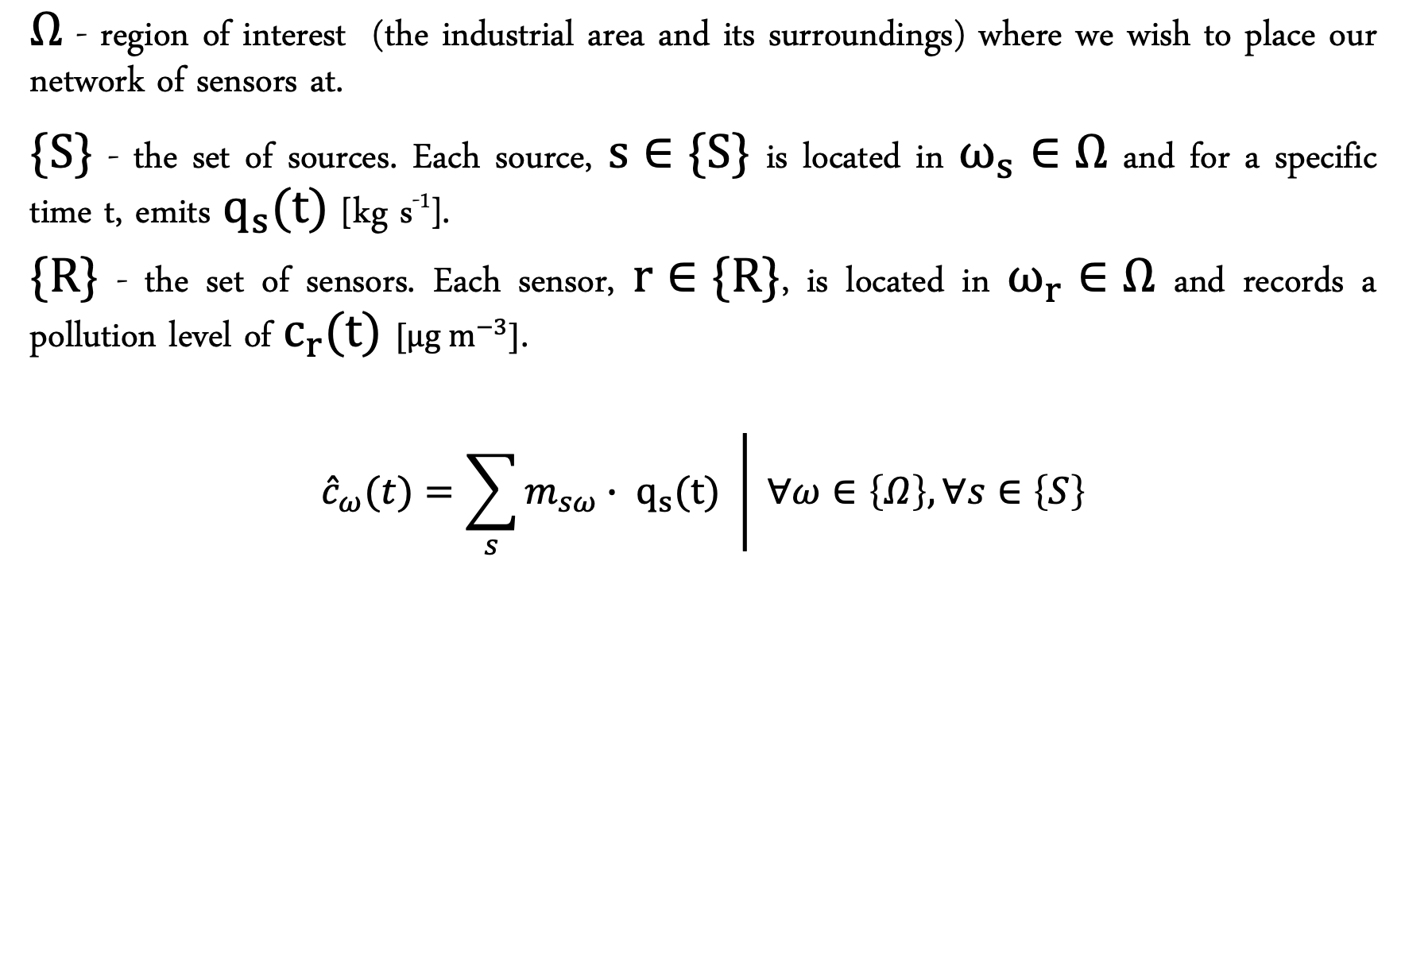
Problem formulation - notation
$Ω$ - region of interest (the industrial area and its surroundings) where we wish to place our network of sensors at.
$\{S\}$ - the set of sources. Each source, $s∈\{S\}$ is located in $ω_{s}∈Ω$ and for a specific time t, emits $q_{s}(t)$ [kg s⁻¹].
$\{R\}$ - the set of sensors. Each sensor, $r∈\{R\}$, is located in $ω_{r}∈Ω$ and records a pollution level of $c_{r}(t)$ $[μg m^{−3}]$.
$$\left.{\hat{c}}_{ω}(t)=\sum_{s}{m_{sω}∙ q_{s}(t) } \right| ∀ω∈\left\{Ω\right\}, ∀s∈\left\{S\right\}$$
Methods

Slide 18
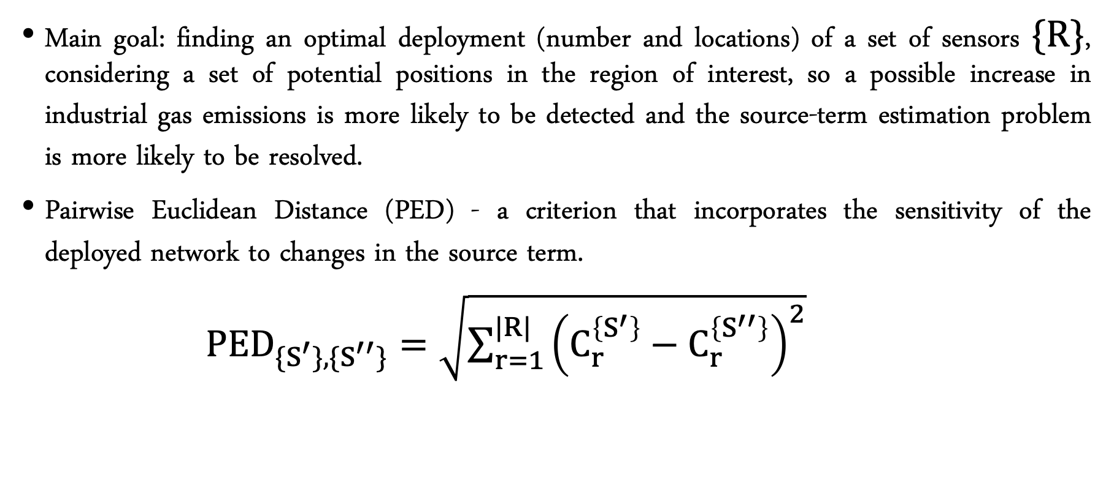
Problem formulation - PED
Main goal: finding an optimal deployment (number and locations) of a set of sensors $\{R\}$, considering a set of potential positions in the region of interest, so a possible increase in industrial gas emissions is more likely to be detected and the source-term estimation problem is more likely to be resolved.
Pairwise Euclidean Distance (PED) - a criterion that incorporates the sensitivity of the deployed network to changes in the source term.
${PED}_{{\{S}^{′}\},\{S^{′′}\}}=\sqrt{\sum_{r=1}^{|R|}{{\left(C_{r}^{\left\{S^{′}\right\}}−C_{r}^{\left\{S^{′′}\right\}}\right)}^{2}}}$
Methods

Slide 19
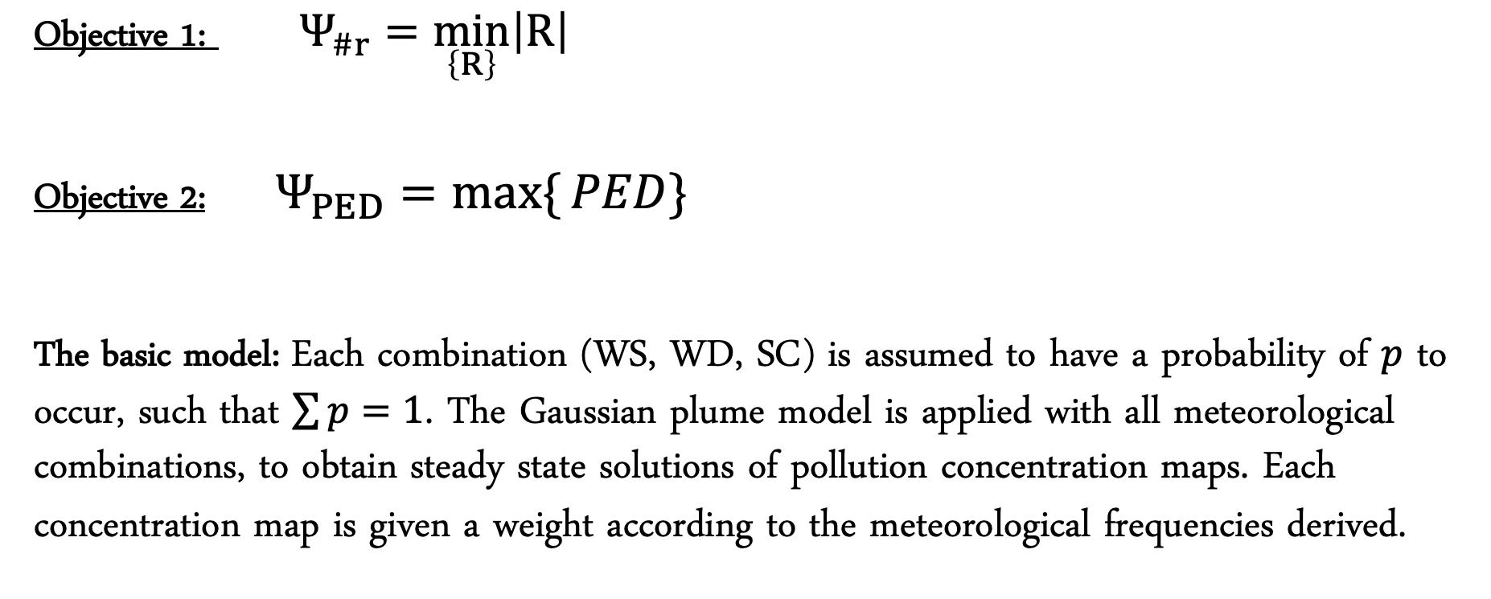
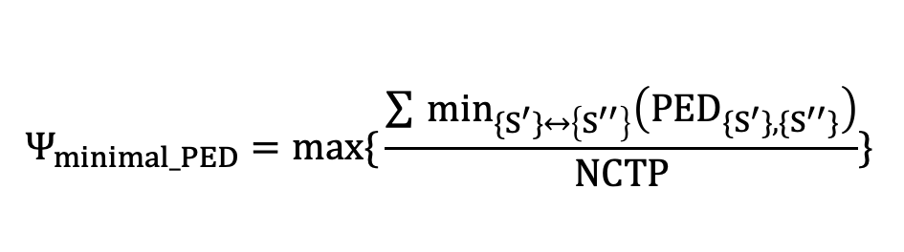
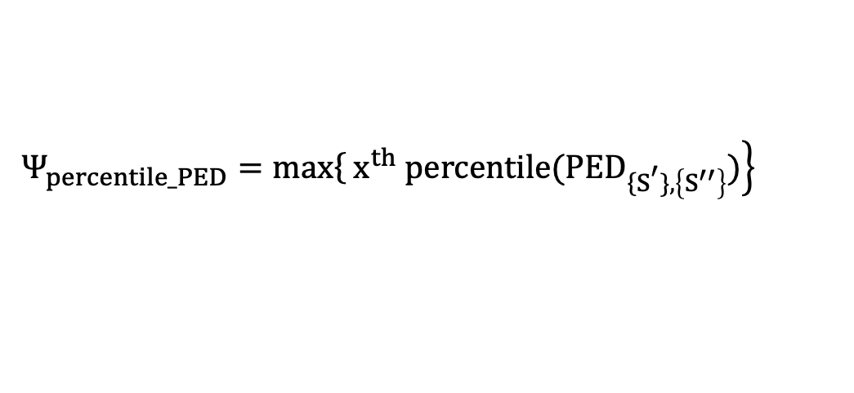
Problem formulation - optimization
Objective 1: $Ψ_{\#r}={\min_{\left\{R\right\}}\left|R\right|}_{ }$
Objective 2: $Ψ_{PED}={\underset{ }{max\{}{PED\}}}_{ }$
The basic model: Each combination (WS, WD, SC) is assumed to have a probability of $p$ to occur, such that $\sum{p=1}$. The Gaussian plume model is applied with all meteorological combinations, to obtain steady state solutions of pollution concentration maps. Each concentration map is given a weight according to the meteorological frequencies derived.
$$Ψ_{minimal_PED}={max\{{\frac{\sum_{ }{\min_{{\{S}^{′}\}↔\left\{S^{′′}\right\}}\left({PED}_{{\{S}^{′}\},\{S^{′′}\}}\right)}}{NCTP}\}}}_{ }$$
$$Ψ_{percentile_PED}={\left.max\right\{\left.x^{th} percentile({PED}_{{\left\{S\right.}^{′}\},\left\{S^{′′}\right\}})\right\}}_{ }$$
Methods

Slide 20
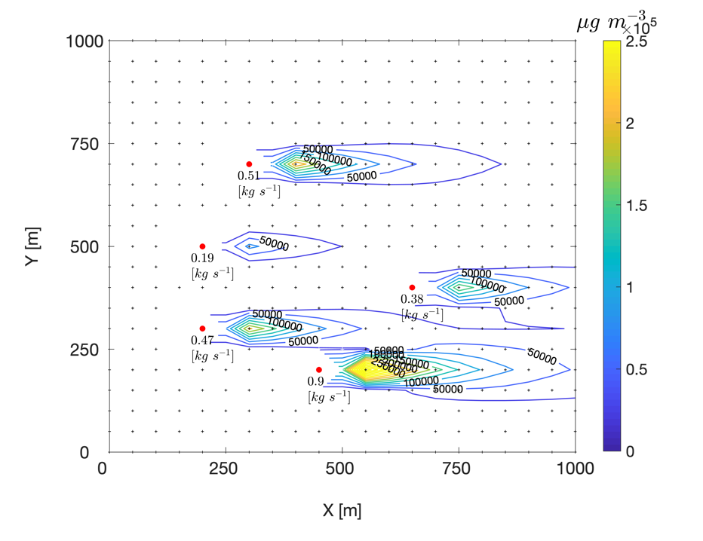
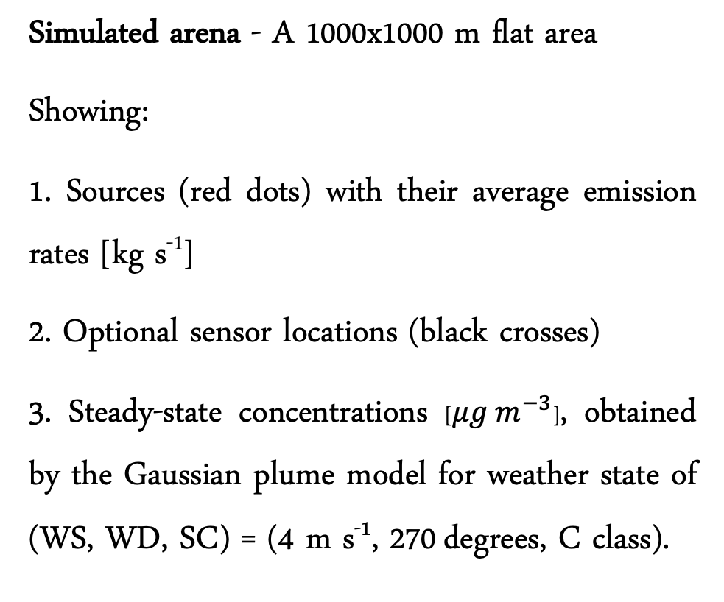
Simulation setup
Simulated arena - A 1000x1000 m flat area
Showing:
1. Sources (red dots) with their average emission rates [kg s⁻¹]
2. Optional sensor locations (black crosses)
3. Steady-state concentrations [$μg m^{−3}$], obtained by the Gaussian plume model for weather state of (WS, WD, SC) = (4 m s⁻¹, 270 degrees, C class).
Optional locations
Sources
Preliminary results

Slide 21
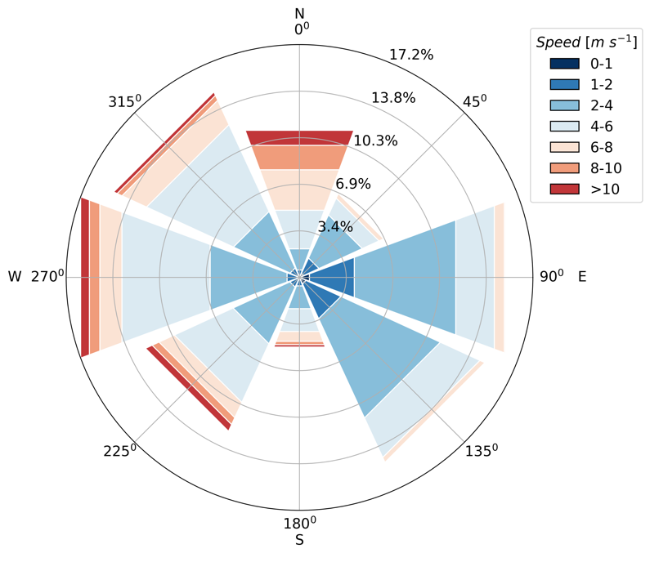
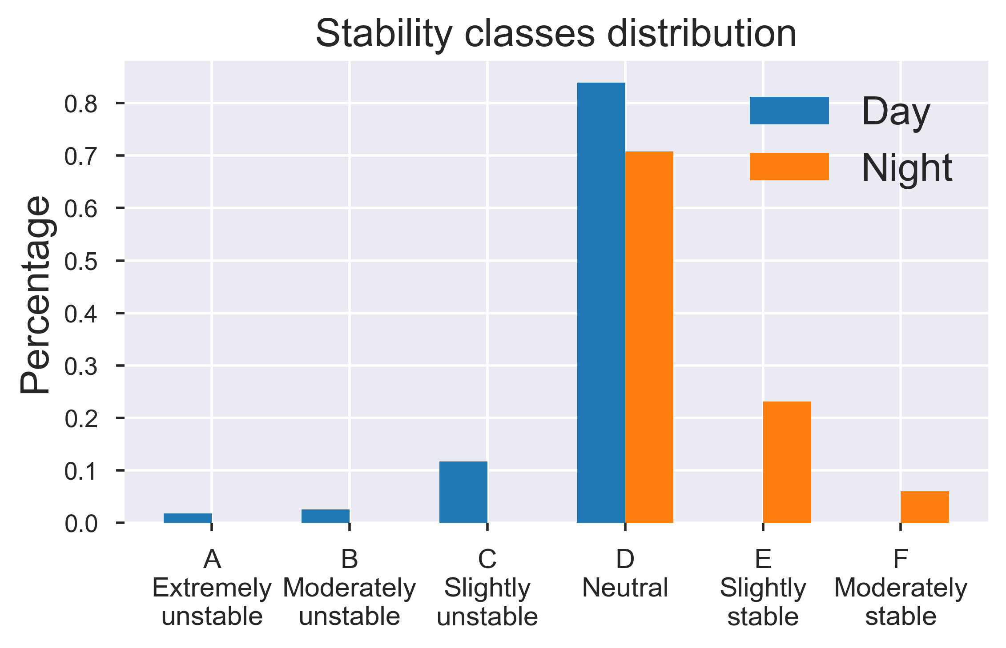
Data used for the simulation
Windrose distribution
Data obtained from IMS for Hadera-port station.
Preliminary results

Slide 22
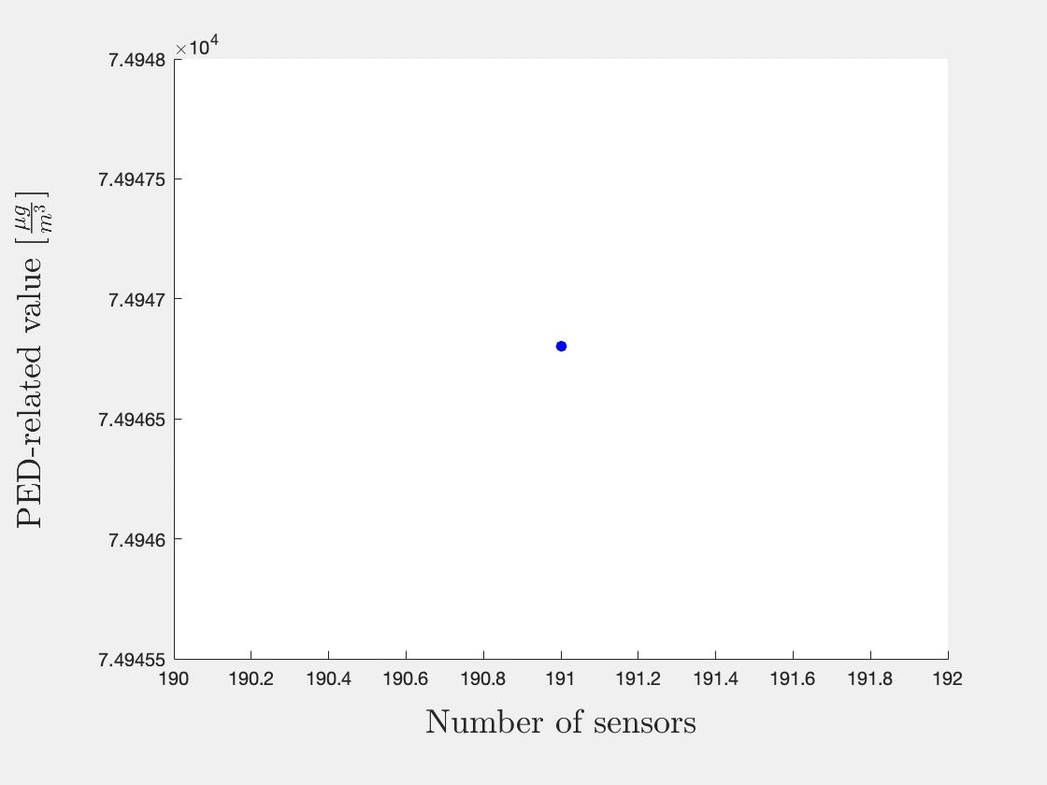
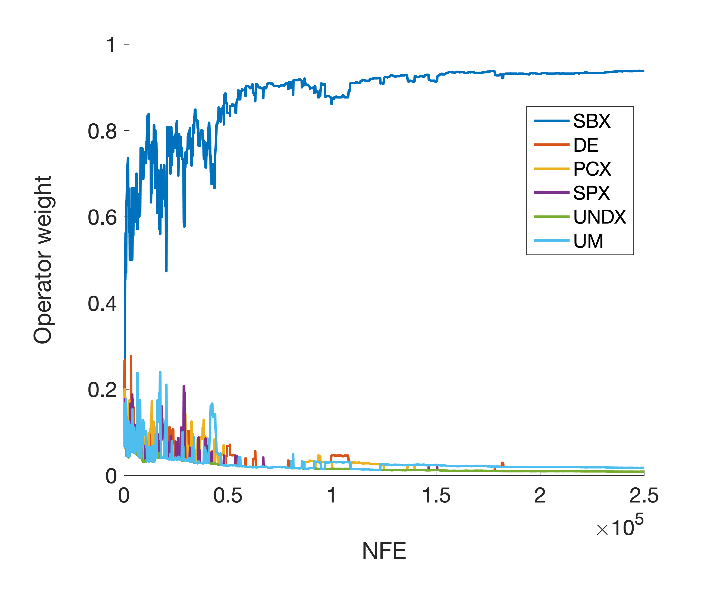
Optimization run
Generation of Pareto frontier
Weights of recombination operators
Preliminary results

Slide 23
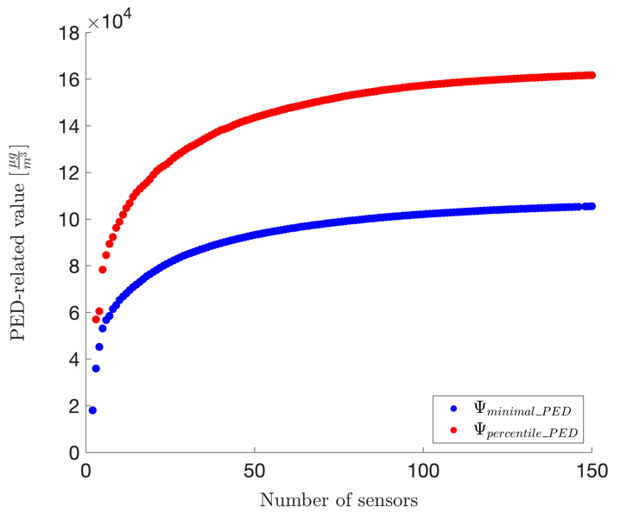
Obtained solutions
Pareto frontier of two optimization runs
Each dot in the figure represents a non-dominated solution, i.e., an optimal solution for a given number of sensors.
The conflict between the cost of the network and its performance is reflected in the Pareto frontier - higher PED values and better network performance are achieved by larger number of sensors but result in a more expensive sensor array.
Preliminary results

Slide 24
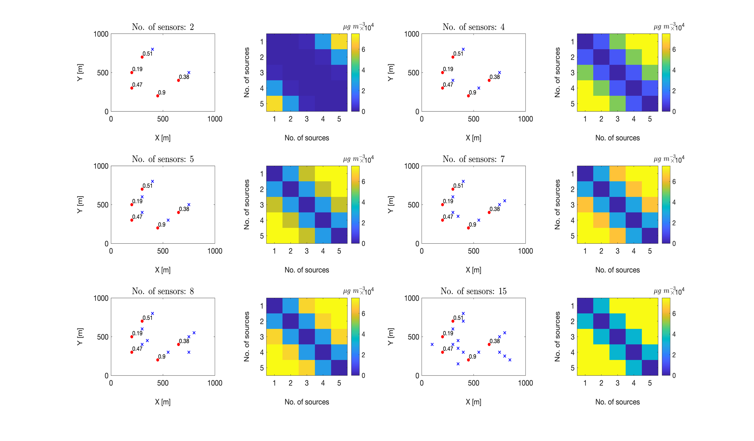
Obtained solutions
b
d
f
a
c
e

Slide 25
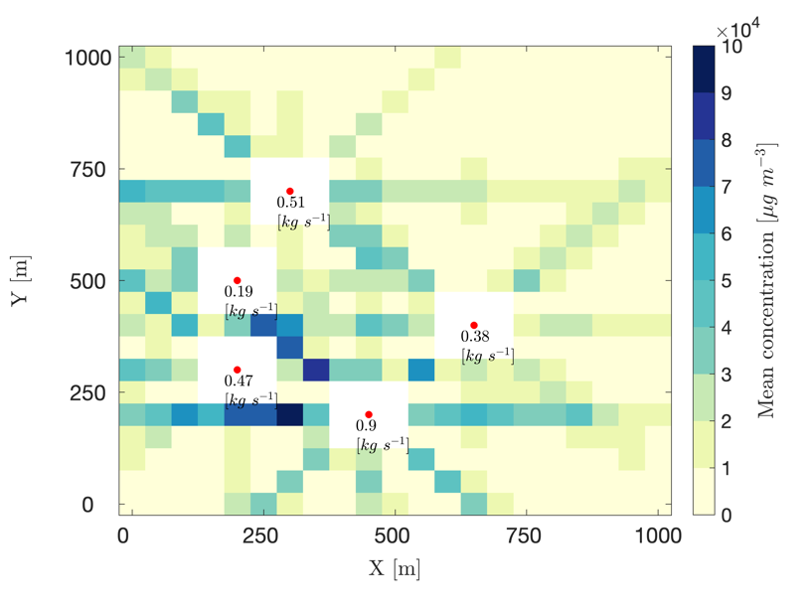
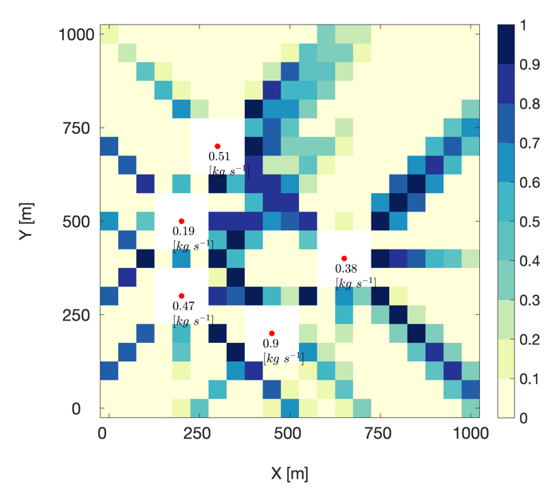
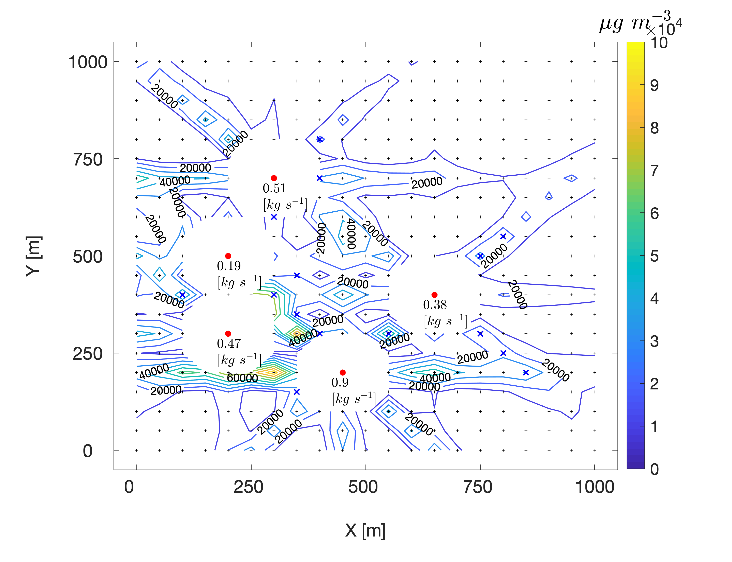
Obtained solutions
Preferable locations and average concentration map
Preferable locations
Average concentration map
Preliminary results

Slide 26
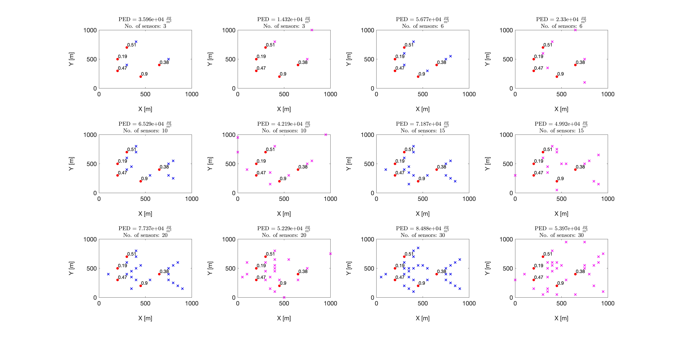
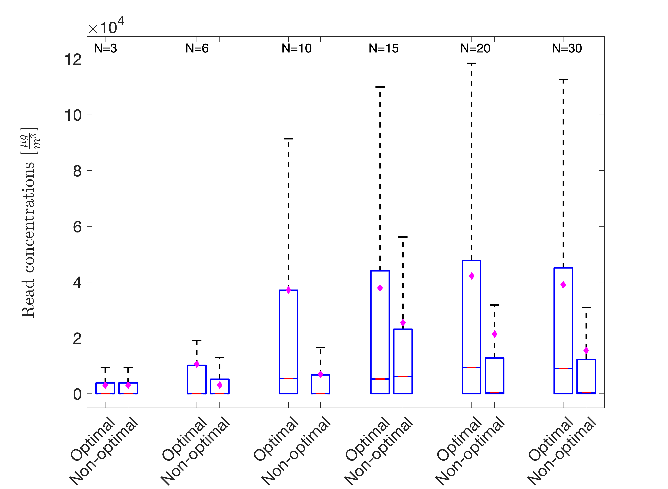
Initial evaluation
Sampled solutions
Readings of optimal Vs. non-optimal solutions
26

Slide 27

Summary and future research plan
Adequate monitoring of ambient air pollution is needed, among others, for regulation on industrial activity
We offer to design and develop a decision-making tool for an optimal deployment in time and in space of heterogenous sensor array, using a multi-objective optimization model, coupled with an air pollution dispersion model
The basic model considers the time varying meteorological conditions (wind velocity and atmospheric stability) and uses as the main objective a quantitative measure of the complexity of the given set of sources/sensors geometries: the Pairwise Euclidean Distance (PED) between the sensor network potential readings of different number of active sources.
Future modules will focus on the development of a temporal optimization module that allocates sensors with minimal transfer effort and on combining the two modules together.
Other aspects will be considers: various sources/sensors configurations, weather conditions and emission rates, heterogenous network, case-study of real-world
Thanks for listening…

Slide 28
References
P. S. Kanaroglou et al., “Establishing an air pollution monitoring network for intra-urban population exposure assessment: A location-allocation approach,” Atmos. Environ., vol. 39, no. 13, pp. 2399–2409, 2005.
A. E. Eiben and J. E. Smith, Introduction to evolutionary computing, 2nd Editio., vol. 53. Springer, 2007.
D. Hadka, “Borg : An Auto-Adaptive Many-Objective Evolutionary Computing Framework,” vol. 21, no. 2, pp. 231–259, 2013.
D. Hadka, “Beginner ’ s Guide to the MOEA Framework,” p. 214, 2017.
C. D. Ahrens and R. Henson, Meteorology Today: An Introduction to Weather, Climate, and the Environment, 12th ed. Cengage Learning, Inc, 2017.
A. Boubrima, W. Bechkit, and H. Rivano, “Optimal WSN Deployment Models for Air Pollution Monitoring,” IEEE Trans. Wirel. Commun., vol. 16, no. 5, pp. 2723–2735, 2017.
J. D. Berman, L. Jin, M. L. Bell, and F. C. Curriero, “Developing a geostatistical simulation method to inform the quantity and placement of new monitors for a follow-up air sampling campaign,” J. Expo. Sci. Environ. Epidemiol., vol. 29, no. 2, pp. 248–257, 2019.

Slide 29
Notes:
Proove its not sorted

Slide 30
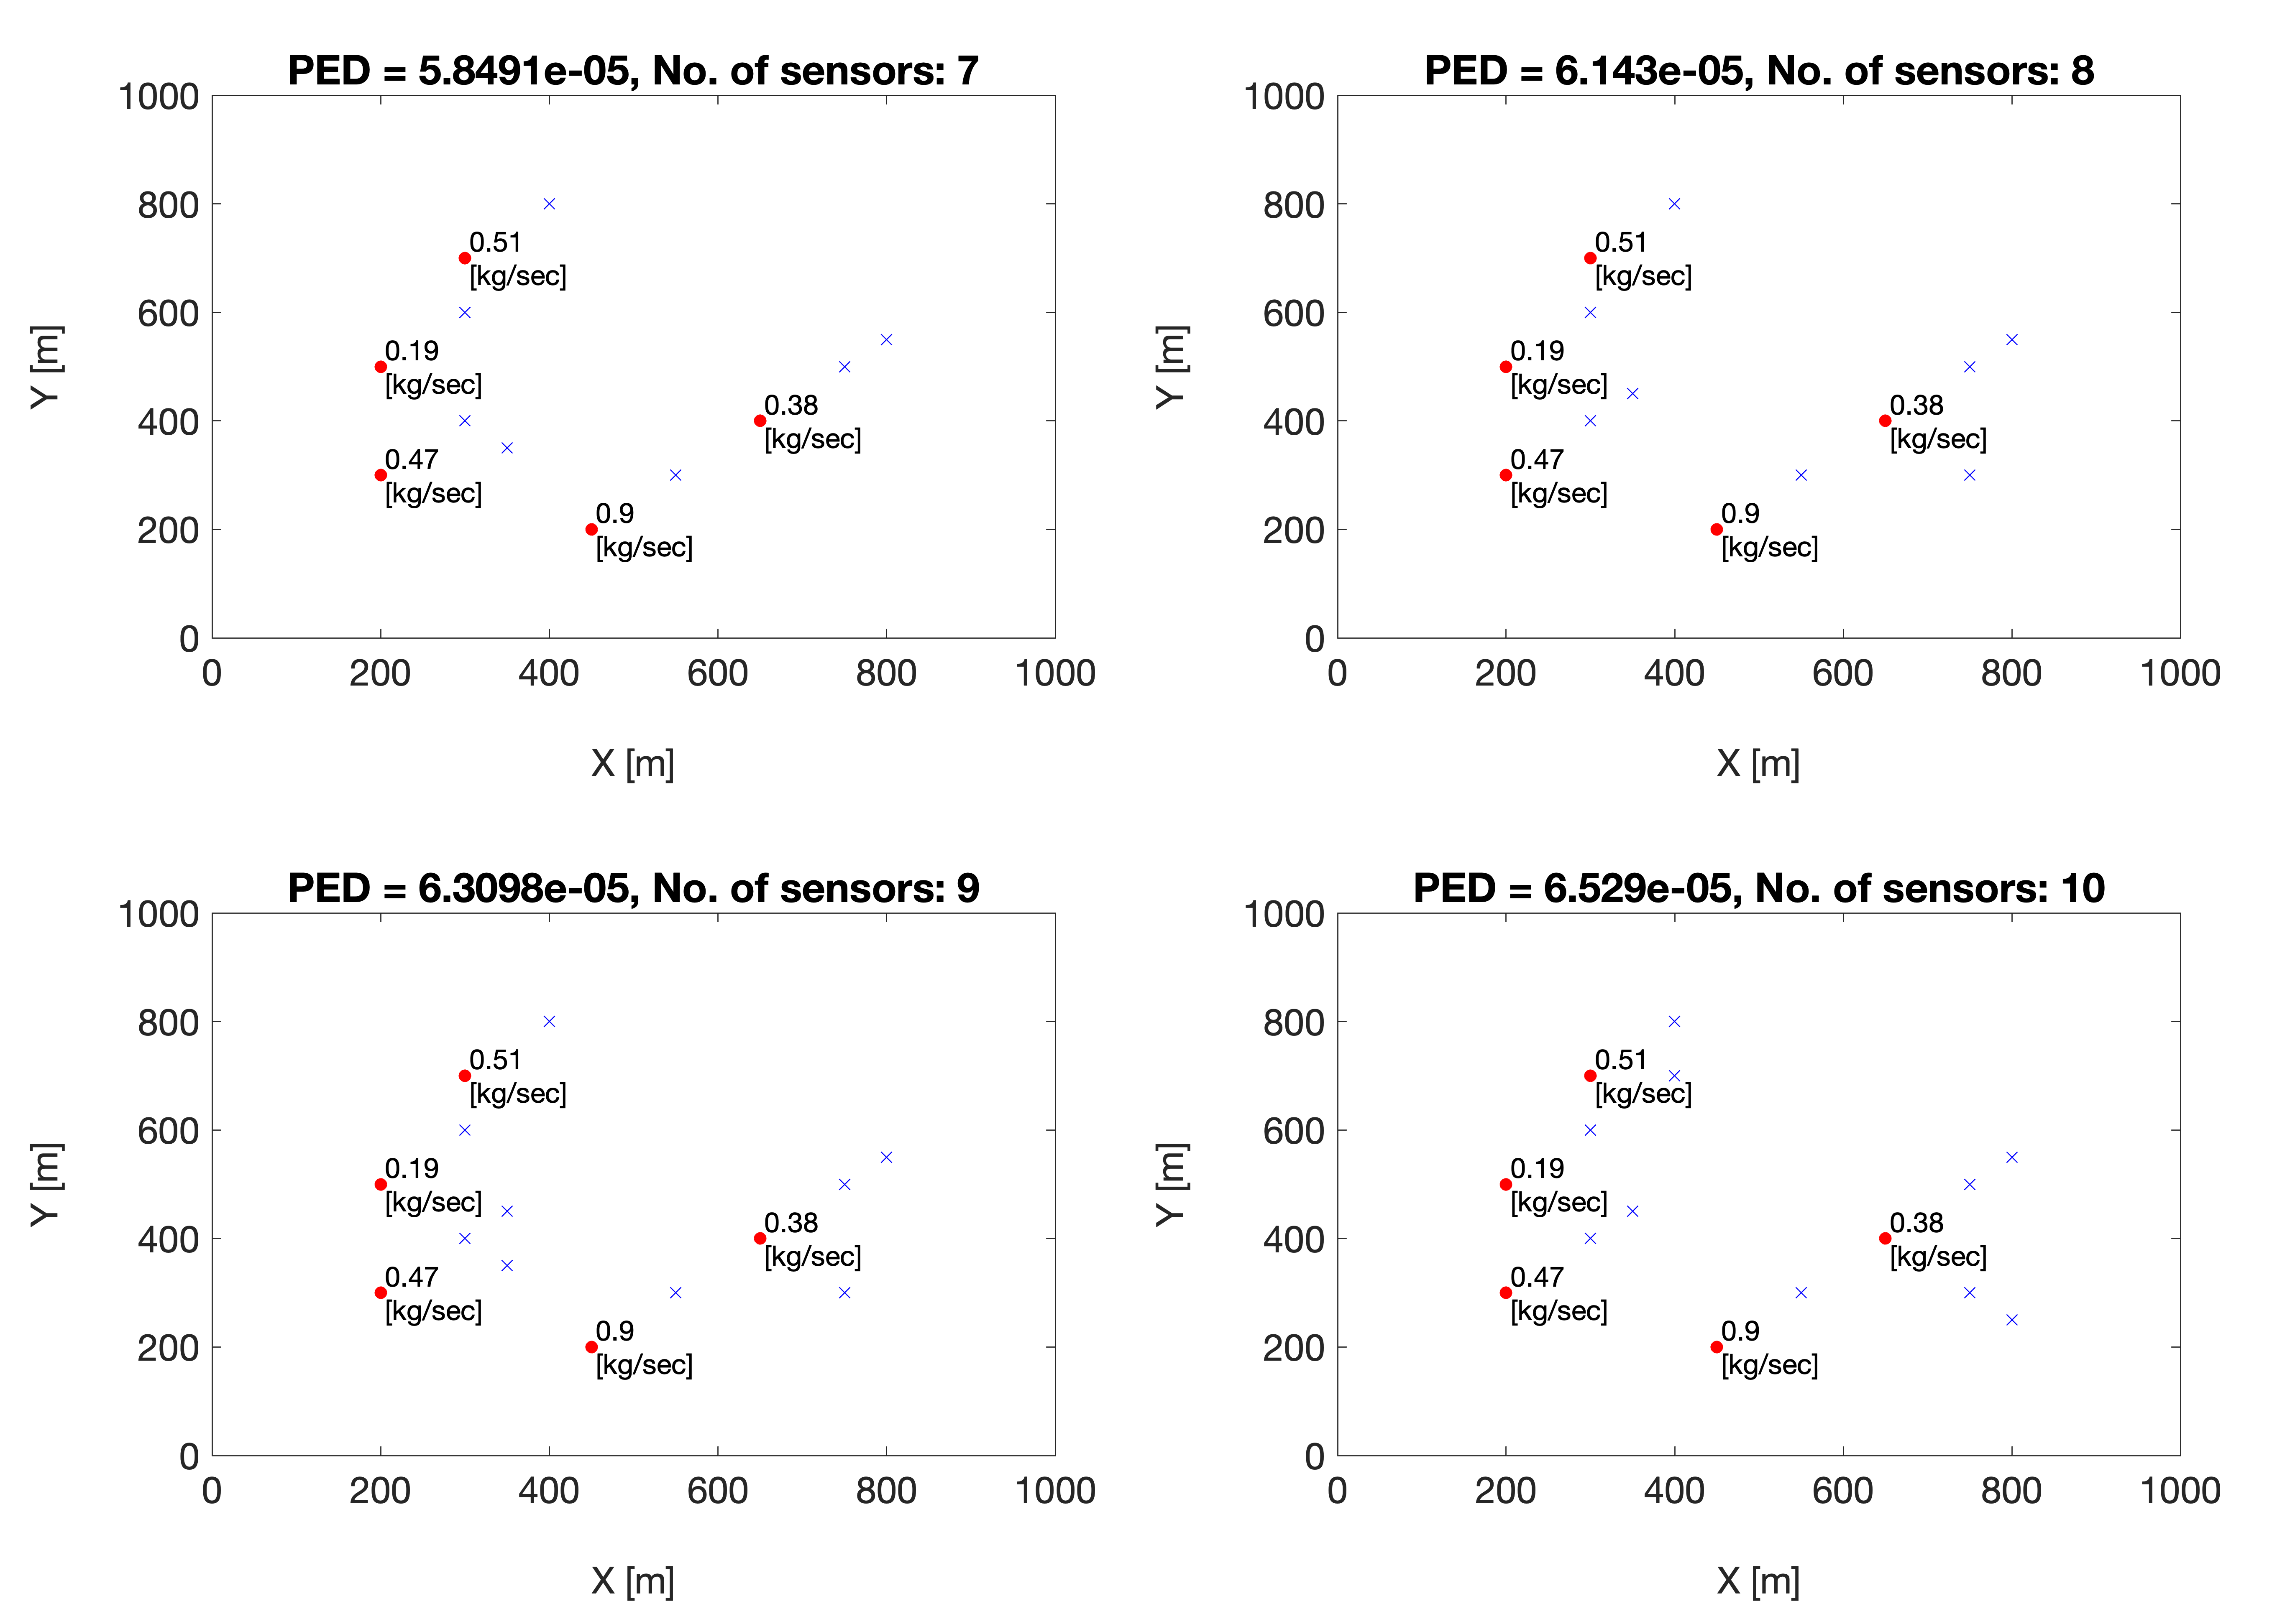
Notes:
See increasing number of sensors not necessarily add one in a new location, sometimes locations are changed

